Slide 1
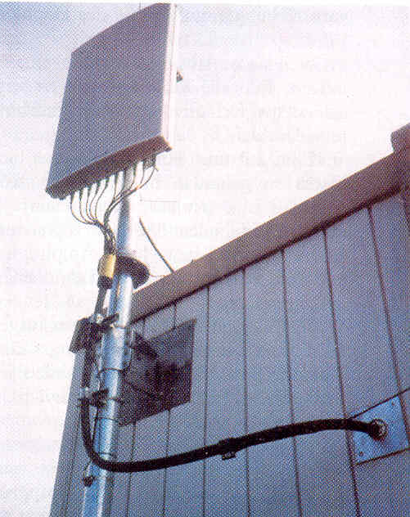
Multiple Access Techniques for Wireless Communication
FDMA
TDMA
SDMA
PDMA
A Presentation by Schäffner Harald

Slide 2
Introduction
many users at same time
share a finite amount of radio spectrum
high performance
duplexing generally required
frequency domain
time domain

Slide 3
Frequency division duplexing (FDD)
two bands of frequencies for every user
forward band
reverse band
duplexer needed
frequency seperation between forward band and reverse band is constant
reverse channel
forward channel
frequency seperation
f

Slide 4
Time division duplexing (TDD)
uses time for forward and reverse link
multiple users share a single radio channel
forward time slot
reverse time slot
no duplexer is required
reverse channel
forward channel
t
time seperation

Slide 5
Multiple Access Techniques
Frequency division multiple access (FDMA)
Time division multiple access (TDMA)
Code division multiple access (CDMA)
Space division multiple access (SDMA)
grouped as:
narrowband systems
wideband systems

Slide 6
Narrowband systems
large number of narrowband channels
usually FDD
Narrowband FDMA
Narrowband TDMA
FDMA/FDD
FDMA/TDD
TDMA/FDD
TDMA/TDD

Slide 7
Logical separation FDMA/FDD
forward channel
user 1
reverse channel
...
f
forward channel
user n
reverse channel
t

Slide 8
Logical separation FDMA/TDD
user 1
forward channel
reverse channel
...
f
user n
forward channel
reverse channel
t

Slide 9
Logical separation TDMA/FDD
forward
channel
forward
channel
user 1
...
user n
f
reverse
channel
reverse
channel
t

Slide 10
Logical separation TDMA/TDD
user 1
user n
...
forward
channel
reverse
channel
forward
channel
reverse
channel
f
t

Slide 11
Wideband systems
large number of transmitters on one channel
TDMA techniques
CDMA techniques
FDD or TDD multiplexing techniques
TDMA/FDD
TDMA/TDD
CDMA/FDD
CDMA/TDD

Slide 12
Logical separation CDMA/FDD
user 1
forward channel
reverse channel
...
code
user n
forward channel
reverse channel
f

Slide 13
Logical separation CDMA/TDD
user 1
forward channel
reverse channel
...
code
user n
forward channel
reverse channel
t

Slide 14
Multiple Access Techniques in use
Multiple Access
Technique
Advanced Mobile Phone System (AMPS) FDMA/FDD
Global System for Mobile (GSM) TDMA/FDD
US Digital Cellular (USDC) TDMA/FDD
Digital European Cordless Telephone (DECT) FDMA/TDD
US Narrowband Spread Spectrum (IS-95) CDMA/FDD
Cellular System

Slide 15
Frequency division multiple access FDMA
one phone circuit per channel
idle time causes wasting of resources
simultaneously and continuously transmitting
usually implemented in narrowband systems
for example: in AMPS is a FDMA bandwidth of 30 kHz implemented

Slide 16
FDMA compared to TDMA
fewer bits for synchronization
fewer bits for framing
higher cell site system costs
higher costs for duplexer used in base station and subscriber units
FDMA requires RF filtering to minimize adjacent channel interference

Slide 17
Nonlinear Effects in FDMA
many channels - same antenna
for maximum power efficiency operate near saturation
near saturation power amplifiers are nonlinear
nonlinearities causes signal spreading
intermodulation frequencies

Slide 18
Nonlinear Effects in FDMA
IM are undesired harmonics
interference with other channels in the FDMA system
decreases user C/I - decreases performance
interference outside the mobile radio band: adjacent-channel interference
RF filters needed - higher costs

Slide 19
Number of channels in a FDMA system
Bt - Bguard
N=
Bc
N … number of channels
Bt … total spectrum allocation
Bguard … guard band
Bc … channel bandwidth

Slide 20
Example: Advanced Mobile Phone System
AMPS
FDMA/FDD
analog cellular system
12.5 MHz per simplex band - Bt
Bguard = 10 kHz ; Bc = 30 kHz
12.5E6 - 2*(10E3)
N=
= 416 channels
30E3

Slide 21
Time Division Multiple Access
time slots
one user per slot
buffer and burst method
noncontinuous transmission
digital data
digital modulation

Slide 22
Repeating Frame Structure
One TDMA Frame
Preamble Information Message Trail Bits
Slot 1 Slot 2 Slot 3 … Slot N
Trail Bits Sync. Bits Information Data Guard Bits
The frame is cyclically repeated over time.

Slide 23
Features of TDMA
a single carrier frequency for several users
transmission in bursts
low battery consumption
handoff process much simpler
FDD : switch instead of duplexer
very high transmission rate
high synchronization overhead
guard slots necessary

Slide 24
Number of channels in a TDMA system
m*(Btot - 2*Bguard)
N=
Bc
N … number of channels
m … number of TDMA users per radio channel
Btot … total spectrum allocation
Bguard … Guard Band
Bc … channel bandwidth

Slide 25
Example: Global System for Mobile (GSM)
TDMA/FDD
forward link at Btot = 25 MHz
radio channels of Bc = 200 kHz
if m = 8 speech channels supported, and
if no guard band is assumed :
8*25E6
N=
= 1000 simultaneous users
200E3

Slide 26
Efficiency of TDMA
percentage of transmitted data that contain information
frame efficiency f
usually end user efficiency < f ,
because of source and channel coding
How get f ?

Slide 27
Repeating Frame Structure
One TDMA Frame
Preamble Information Message Trail Bits
Slot 1 Slot 2 Slot 3 … Slot N
Trail Bits Sync. Bits Information Data Guard Bits
The frame is cyclically repeated over time.

Slide 28
Efficiency of TDMA
bOH = Nr*br + Nt*bp + Nt*bg + Nr*bg
bOH … number of overhead bits
Nr … number of reference bursts per frame
br … reference bits per reference burst
Nt … number of traffic bursts per frame
bp … overhead bits per preamble in each slot
bg … equivalent bits in each guard time intervall

Slide 29
Efficiency of TDMA
bT = Tf * R
bT … total number of bits per frame
Tf … frame duration
R … channel bit rate

Slide 30
Efficiency of TDMA
f = (1-bOH/bT)*100%
f … frame efficiency
bOH … number of overhead bits per frame
bT … total number of bits per frame

Slide 31
Space Division Multiple Access
Controls radiated energy for each user in space
using spot beam antennas
base station tracks user when moving
cover areas with same frequency:
TDMA or CDMA systems
cover areas with same frequency:
FDMA systems

Slide 32
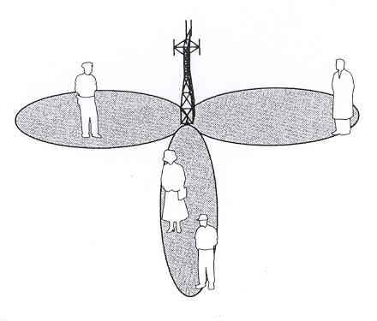
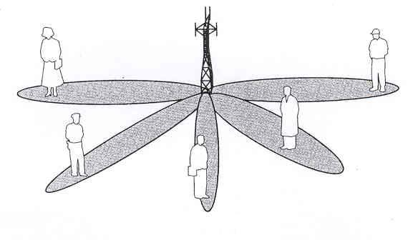
Space Division Multiple Access
primitive applications are “Sectorized antennas”
in future adaptive antennas simultaneously steer energy in the direction of many users at once

Slide 33
Reverse link problems
general problem
different propagation path from user to base
dynamic control of transmitting power from each user to the base station required
limits by battery consumption of subscriber units
possible solution is a filter for each user

Slide 34
Solution by SDMA systems
adaptive antennas promise to mitigate reverse link problems
limiting case of infinitesimal beamwidth
limiting case of infinitely fast track ability
thereby unique channel that is free from interference
all user communicate at same time using the same channel

Slide 35
Disadvantage of SDMA
perfect adaptive antenna system: infinitely large antenna needed
compromise needed

Slide 36
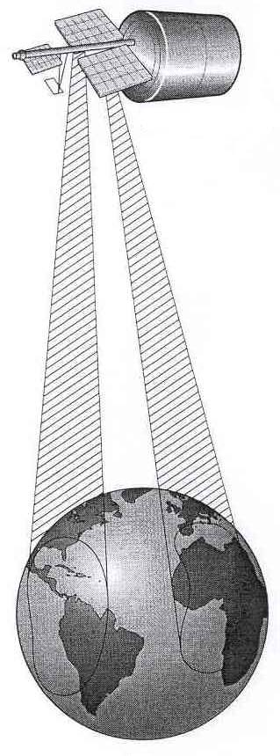
SDMA and PDMA in satellites
INTELSAT IVA
SDMA dual-beam receive antenna
simultaneously access from two different regions of the earth

Slide 37
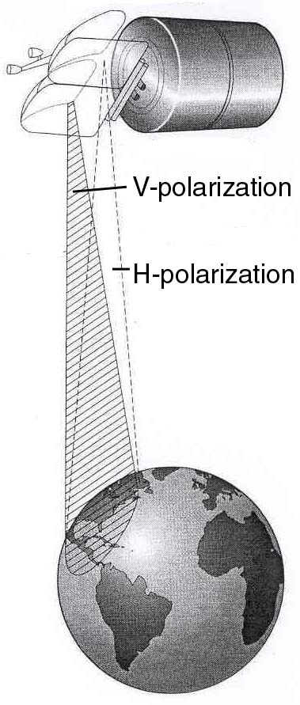
SDMA and PDMA in satellites
COMSTAR 1
PDMA
separate antennas
simultaneously access from same region

Slide 38
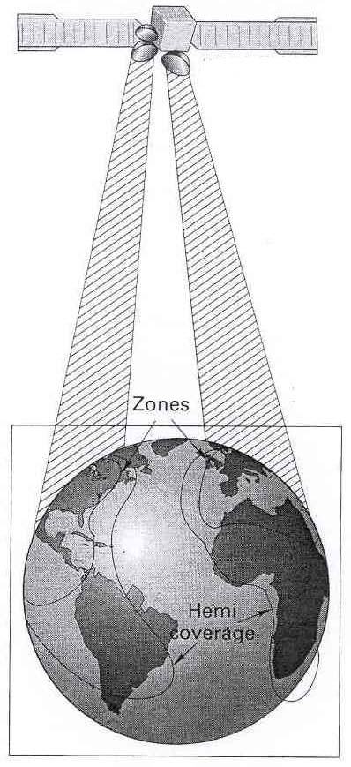
SDMA and PDMA in satellites
INTELSAT V
PDMA and SDMA
two hemispheric coverages by SDMA
two smaller beam zones by PDMA
orthogonal polarization

Slide 39
Capacity of Cellular Systems
channel capacity: maximum number of users in a fixed frequency band
radio capacity : value for spectrum efficiency
reverse channel interference
forward channel interference
How determine the radio capacity?

Slide 40
Co-Channel Reuse Ratio Q
Q=D/R
Q … co-channel reuse ratio
D … distance between two co-channel cells
R … cell radius

Slide 41
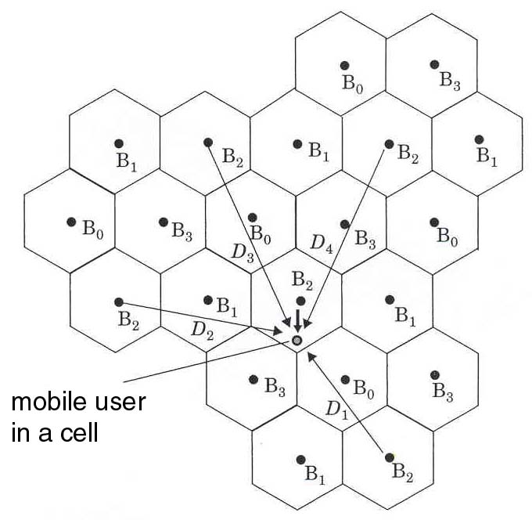
Forward channel interference
cluster size of 4
D0 … distance serving station to user
DK … distance co-channel base station to user

Slide 42
Carrier-to-interference ratio C/I
M closest co-channels cells cause first order interference
C
-n0
D0
=
I
M
-nk
DK
k=1
n0 … path loss exponent in the desired cell
nk … path loss exponent to the interfering base station

Slide 43
Carrier-to-interference ratio C/I
Assumption:
just the 6 closest stations interfere
all these stations have the same distance D
all have similar path loss exponents to n0
-n
C
D0
=
-n
I
6*D

Slide 44
Worst Case Performance
maximum interference at D0 = R
(C/I)min for acceptable signal quality
following equation must hold:
1/6 * (R/D) (C/I)min
-n
>
=

Slide 45
Co-Channel reuse ratio Q
Q = D/R = (6*(C/I)min)
1/n
D … distance of the 6 closest interfering base stations
R … cell radius
(C/I)min … minimum carrier-to-interference ratio
n … path loss exponent

Slide 46
Radio Capacity m
Bt
m =
radio channels/cell
Bc * N
Bt … total allocated spectrum for the system
Bc … channel bandwidth
N … number of cells in a complete frequency reuse cluster

Slide 47
Radio Capacity m
N is related to the co-channel factor Q by:
Q = (3*N)
1/2
Bt
Bt
m=
=
6
C
2/n
Bc * (Q²/3)
(
*(
)
)
Bc *
3
n/2
I
min

Slide 48
Radio Capacity m for n = 4
Bt
m =
Bc *
2/3 * (C/I)min
m … number of radio channels per cell
(C/I)min lower in digital systems compared to analog systems
lower (C/I)min imply more capacity
exact values in real world conditions measured

Slide 49
Compare different Systems
each digital wireless standard has different (C/I)min
to compare them an equivalent (C/I) needed
keep total spectrum allocation Bt and number of rario channels per cell m constant to get (C/I)eq :

Slide 50
Compare different Systems
C
C
Bc
(
)
=
(
)
(
)²
*
I
eq
I
min
Bc’
Bc … bandwidth of a particular system
(C/I)min … tolerable value for the same system
Bc’ … channel bandwidth for a different system
(C/I)eq … minimum C/I value for the different system

Slide 51
C/I in digital cellular systems
C Eb*Rb Ec*Rc
=
=
I I I
Rb … channel bit rate
Eb … energy per bit
Rc … rate of the channel code
Ec … energy per code symbol

Slide 52
C/I in digital cellular systems
combine last two equations:
(C/I) (Ec*Rc)/I Bc’
=
=
(
)²
(C/I)eq (Ec’*Rc’)/I’ Bc
The sign ‘ marks compared system parameters

Slide 53
C/I in digital cellular systems
Relationship between Rc and Bc is always linear (Rc/Rc’ = Bc/Bc’ )
assume that level I is the same for two different systems ( I’ = I ) :
Ec Bc’
= (
)³
Ec‘ Bc

Slide 54
Compare C/I between FDMA and TDMA
Assume that multichannel FDMA system occupies same spectrum as a TDMA system
FDMA : C = Eb * Rb ; I = I0 * Bc
TDMA : C’ = Eb * Rb’ ; I’ = I0 * Bc’
Eb … Energy per bit
I0 … interference power per Hertz
Rb … channel bit rate
Bc … channel bandwidth

Slide 55
Example
A FDMA system has 3 channels , each with a bandwidth of 10kHz and a transmission rate of 10 kbps.
A TDMA system has 3 time slots, a channel bandwidth of 30kHz and a transmission rate of 30 kbps.
What’s the received carrier-to-interference ratio for a user ?

Slide 56
Example
In TDMA system C’/I’ be measured in 333.3 ms per second - one time slot
C’ = Eb*Rb’ = 1/3*(Eb*10E4 bits) = 3*Rb*Eb=3*C
I’ = I0*Bc’ = I0*30kHz = 3*I
In this example FDMA and TDMA have the same radio capacity (C/I leads to m)

Slide 57
Example
Peak power of TDMA is 10logk higher then in FDMA ( k … time slots)
in practice TDMA have a 3-6 times better capacity

Slide 58
Capacity of SDMA systems
one beam each user
base station tracks each user as it moves
adaptive antennas most powerful form
beam pattern G() has maximum gain in the direction of desired user
beam is formed by N-element adaptive array antenna

Slide 59
Capacity of SDMA systems
G() steered in the horizontal  -plane through 360°
G() has no variation in the elevation plane to account which are near to and far from the base station
following picture shows a 60 degree beamwidth with a 6 dB sideslope level

Slide 60
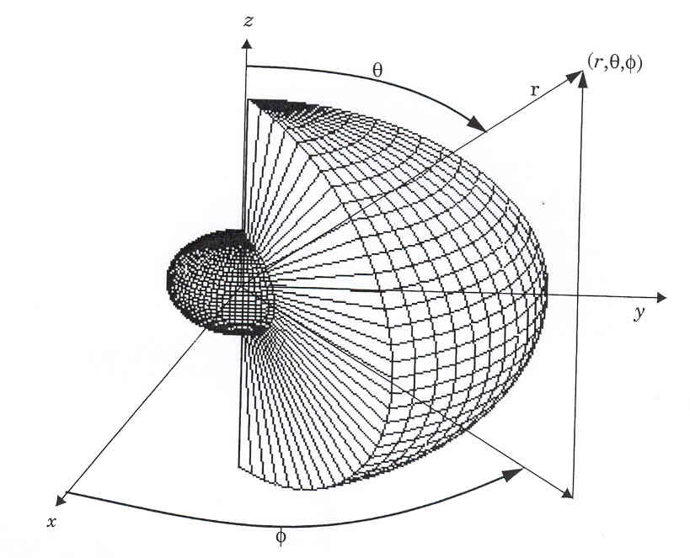
Capacity of SDMA systems

Slide 61
Capacity of SDMA systems
reverse link received signal power, from desired mobiles, is Pr;0
interfering users i = 1,…,k-1 have received power Pr;I
average total interference power I seen by a single desired user:

Slide 62
Capacity of SDMA
I = E {  G(i) Pr;I}
K-1
i=1
i … direction of the i-th user in the horizontal plane
E … expectation operator

Slide 63
Capacity of SDMA systems
in case of perfect power control (received power from each user is the same) :
Pr;I = Pc
Average interference power seen by user 0:
I = Pc E {  G(i) }
K-1
i=1

Slide 64
Capacity of SDMA systems
users independently and identically distributed throughout the cell:
I = Pc *(k -1) * 1/D
D … directivity of the antenna - given by max(G())
D typ. 3dB …10dB

Slide 65
Capacity of SDMA systems
Average bit error rate Pb for user 0:
Pb = Q ( )
3 D N
K-1
D … directivity of the antenna
Q(x) … standard Q-function
N … spreading factor
K … number of users in a cell

Slide 66
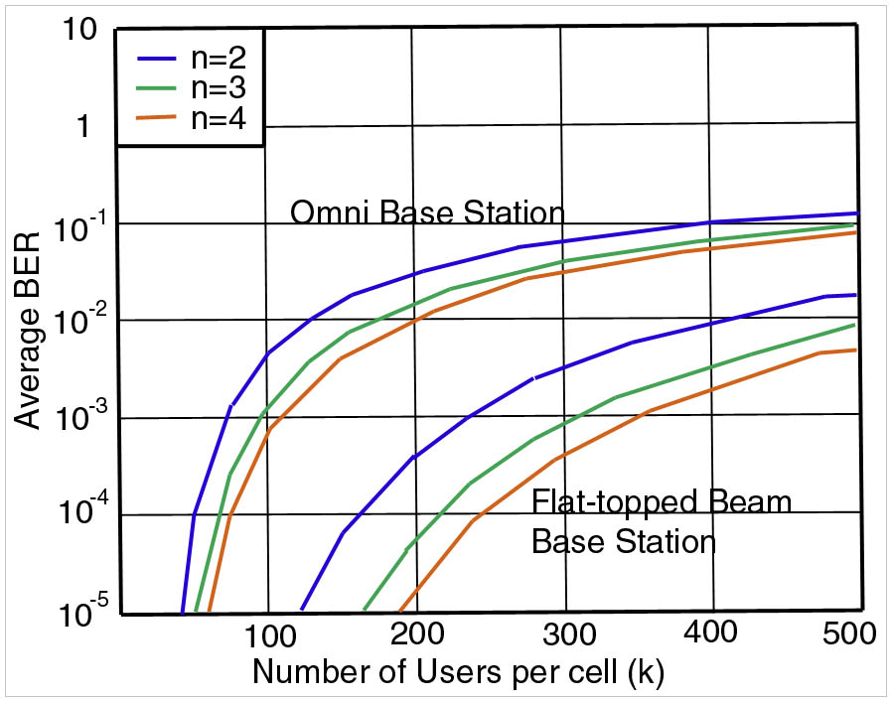
Capacity of SDMA systems

